Slide 1
Seattle Building Permits 2005 to 2018
By Raman Gill

Slide 2
Project goals:
To analyze building permits for City of Seattle, Washington, USA through from 1920s to 2020s
Which permit applicants has highest value.
What is the maximum value of permit in each category.
How many permits filed and issued each year.

Slide 3
Data Source:
Kaggle
https://www.kaggle.com/datasets/city-of-seattle/seattle-building-permits

Slide 4
Data Review and Cleaning:
Performed In excel and Power Query
Duplicates
Blank Cells
Conditional columns in power query for permit issued values.

Slide 5
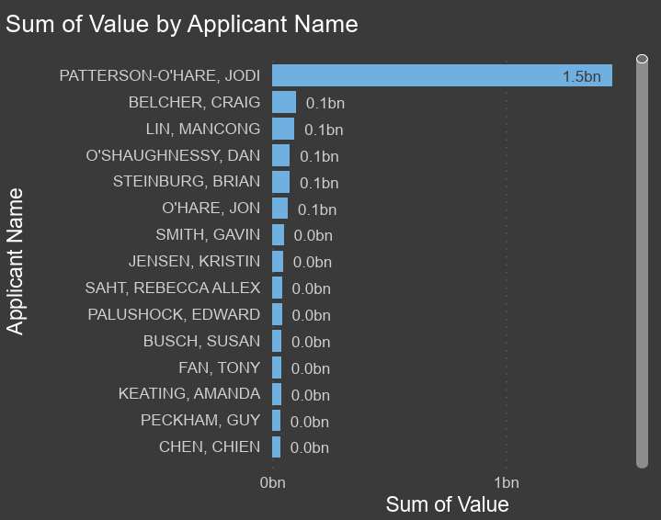
Who are the top applicants by total value of the permits?
The top applicants with highest total value of permits are
Jodi Patterson
Craig Belcher
Mancong Lin

Slide 6
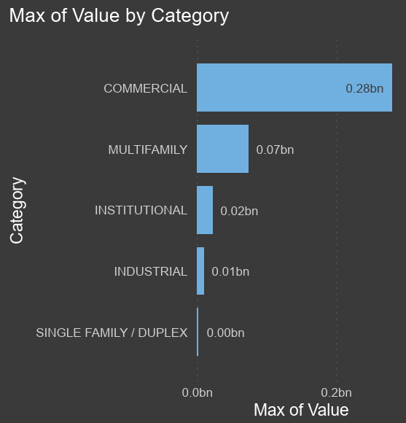
Which category has the maximum permit value?
The maximum permit value is under commercial building and is about 280 million.

Slide 7
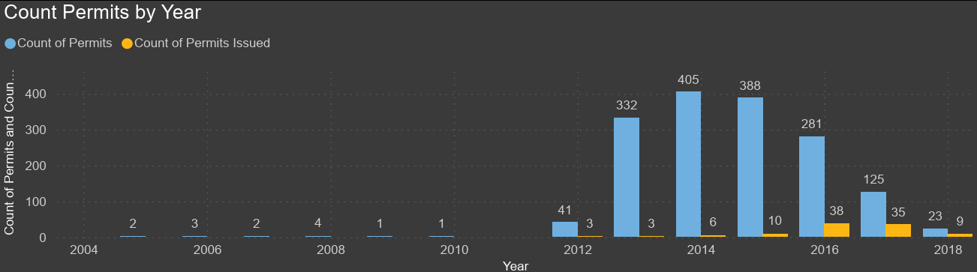
How many permits filed and issued each year?

